Slide 1
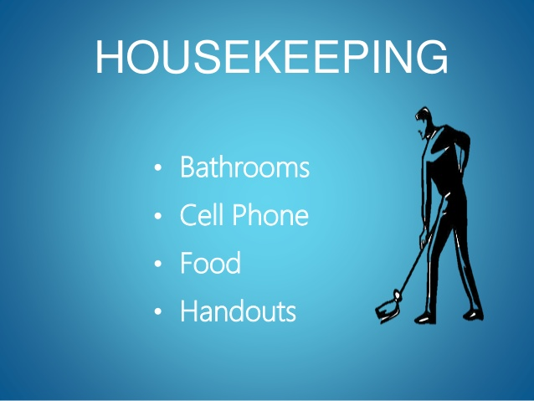
Notes:
Bathrooms, fine,
Cell phones, will be used later for an online poll, but put it on silent mode now
Snack is Okay, lunch time,
Hand outs; get one, and sign in sheet
election day, step outside when needed for parking issues.

Slide 2

PD Goals
To understand how prompting, fading, and data collection affect student growth and independence. (prompts: least to most)
To provide paras with effective strategies on the literacy development of struggling students.
To assist paras develop independent, self-regulated work habits for working with poor readers.
Notes:
The topic that I chose for today’s PD is actually more relevant to the folks working in the IBC program, because it is about prompting strategies in ABA psy. , and it is often by a beh. specialist who gives such a PD. My area of ex. is RD (Dylexia) and MD (Dyslexia) …..but LD and BSBC are similar to each other in the sense they both try to look for ways to make students more independent and more successful, and a part of my dissertation is about measuring the effectiveness of evi. based- strategies, and prompting is a strategy that I will focus on.
Many of these prompting strategies will be familiar to you and you might be surprised that much of that is not new!

Slide 3
Session Agenda
What is prompting?
Why do we need to foster student independence?
Different types of prompts
Prompt hierarchy
Case studies and demonstrations
Q/A Session
Final thoughts and evaluation of the PD

Slide 4

Definition
Prompting is a means to induce an individual with added stimuli (prompts) to perform a desired behavior. A prompt is like a cue or support to encourage a desired behavior that otherwise does not occur. In other words, a prompt is an antecedent that is provided when an ordinary antecedent is not effective.
Prompts increase the success of the student.
Prompting may occur at the same time as the request, right after the request, or even before the request.
Notes:
Def: teacher behaviors presented to increase the probability of correct
responding (assistance provided by the teacher).
AKA: cues, hints, scaffolds, checklist, hand-over-hand help.

Slide 5

Caution
When working with lower achieving students, we must be careful to not create a dependency effect where students come to expect aides or paraprofessionals to prompt them or monitor their completion.
Notes:
Our goal as paraeducators is to help students with disabilities become as independent as possible throughout the school, home, and community.

Slide 6
Student Independence
What is it?
Freedom from the influence or control of others
Completing a task without undo assistance
Using resources to meet your personal needs
Self-help (a.k.a. Self-advocating)
Making appropriate choices and decisions
Being able to say, “I can do it myself!”
Notes:
We need to increase student independence by using prompts effectively. But Student independence means that students are free from influence or control of others. They can complete a task without undo assistance. They are able to use resources to meet their personal needs.
They have techniques through which they can help themselves and ask for assistance when needed.
Self-help or self-advocacy involves the student sharing their needs with others (e.g. “please speak louder…I am hard of hearing).
Students become independent when they can make appropriate choices and decision, and when they are able to say “I can do it myself!” All of these bulleted points show student independence.

Slide 7
Student Independence
What is it?
Students… “need a supportive environment to function successfully in school—and later in the workplace. A supportive environment enables them to capitalize on their strengths and minimize or cope effectively with their weaknesses” (Larkin, 2001)
Notes:
Larkin states, students “need a supportive environment to function successfully in school—and later in the workplace. A supportive environment enables them to capitalize on their strengths and minimize or cope effectively with their weakness.” With this in mind, what are the benefits of building student independence? (Next slide)
Reference: Larkin, M. J., (2001). Providing support for student independence through scaffolded instruction. Teaching Exceptional Children, 34, (1). p. 30.

Slide 8
Why to Build Independence?
Builds self-esteem
Motivates a student to achieve
Gives student a sense of purpose
Social acceptance
Reduces stereotypic labels
Allows teachers to focus on instruction
Notes:
Independence offers a way for the student to do for himself. It builds self-esteem.
When a student is able to complete a task with minimal assistance, it motivates them to achieve even more. Success breeds success. Math and SC,
Accomplishing a small task motivates the student to go for an even bigger goal. Therefore, they have a reason or a purpose for being in school, working on a job, and giving it there best effort.
A student that is able to complete tasks, to cooperate in a team, or to behave in an appropriate manner are more readily accepted by their peers and those within their environment.
Often students with disabilities are labeled as unable to complete a task, when the student could complete the task under the right direction and with explicit instruction. Whether the student’s need focuses on a social skills, an academic task, or a self-help skill, it is important that we help our students learn to work toward independence.
Another benefit of independence is that the teacher has more time to focus on instruction. These are some of the reasons why the topic of student independence is so important to our students
Let’s review some of the basic features of prompting.

Slide 9
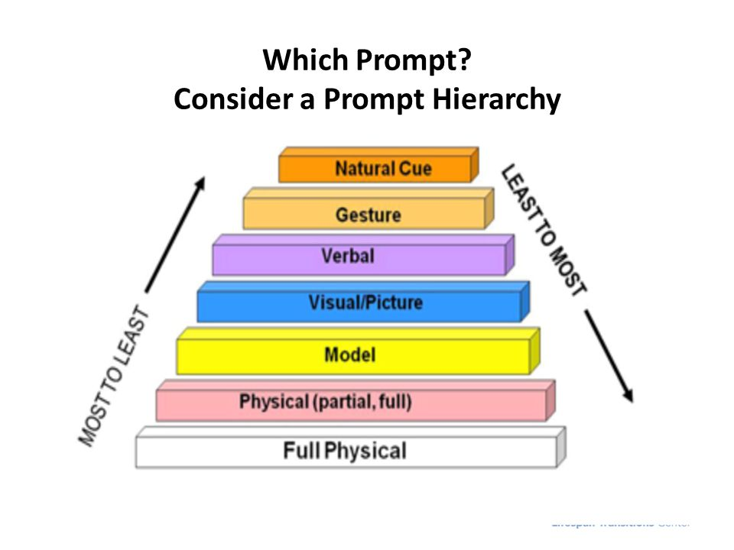
Prompt Hierarchy
Allow the student to attempt the task before interventions. Start with the least instructive prompt and move through the list until the desired behavior is achieved.
The prompt selected should be based upon what the student requires to be successful, while being the least intrusive as possible.
V
Notes:
There are several different types of prompts and they vary in their level of intrusiveness b/o the prompt hierarchy (pg. 2).
Here is a hierarchy of prompts. Notice the direction of prompts from least to most intrusive and vice versa. So for the system of least prompts you would choose a prompt hierarchy starting with the least intrusive and moving toward more intrusive. Typically 3 to 4 prompts are in a hierarchy so an example of a system of least prompts hierarchy after the presentation of the natural cue
might be a verbal prompt, model prompt, and physical prompt. Prompt hierarchies are very individualized so a hierarchy that works for one student may not work for another.
Hierarchy of prompts- a group of prompts arranged in some order of amounts of assistance. In this pyramid, the prompts are ordered from those that provide the least amount of assistance to those that provide the most amount of assistance. When using prompts, give only ONE at a time, according to the hierarchy.
The prompt selected should be based upon what the student requires to be successful, while being the least intrusive as possible. When teaching new skills, most-to-least prompting is most beneficial.
Most-to-least prompting begins with the most intrusive level of prompt required for student success. When reviewing mastered (learned) skills, least-to-most prompting can be used. Least-to-most prompting is where minimal assistance is initially provided and increased if necessary for the student to respond correctly.

Slide 10
Natural/Environmental Prompt
Consider access method for the student
Consider if the student is left or right handed (put in middle)
Consider if the student throws items when in a melt-down
Consider if the item itself is easily accessible e.g., coat/jacket
Notes:
You can design the learning environment in advance that the student finds a higher chance to do a task independently. Simply, put things in a way that a student is likely to take it
Consider the access method for the student; seat near by the board, or away from the door
Left or right handed; put the pencil and paper near by the writing hand, with an easier or so the student can make corrections.
Throwing items; This is a preventative intervention for students with behavior difficulties,if the stude. often experiences melt down, do not put any sharp objects next to him.

Slide 11
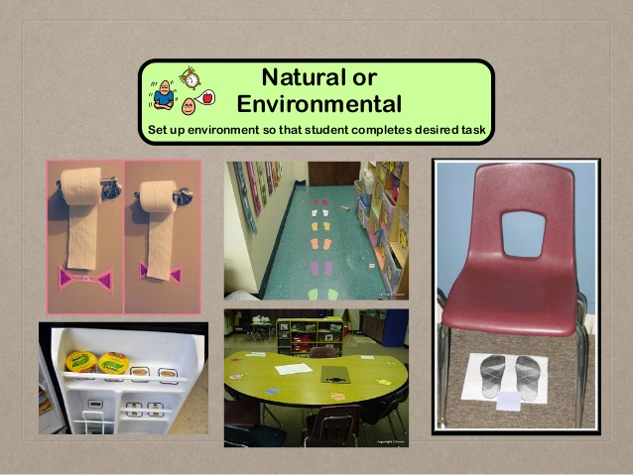
Natural/Environmental Prompt

Slide 12
Gesture Prompt
Gesturing (e.g. pointing to, looking at, moving, or touching an item or area) to indicate a correct response.
Pointing, facial expression, mouthing words silently or indicating the physical movement you want the student to do.
Example: The paraprofessional points to the visual schedule on a student’s desk to signal time for a transition.
A gestural prompt with a toddler:
https://www.youtube.com/watch?time_continue=10&v=Nrgoox-fS5Q
Notes:
Taping on the shoulder to indicate a correct lining-up for lunch.

Slide 13
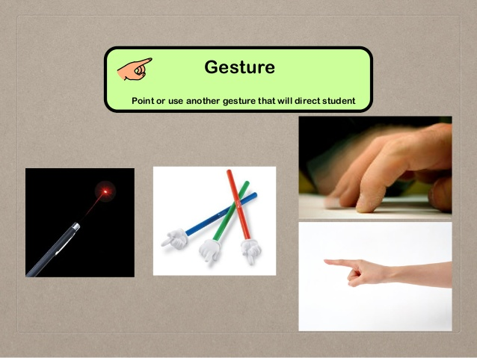
Gesture Prompt
Notes:
When using gesture prompt, you can use laser pointers, pencil pointers, or your finger; whichever is more appropriate and cost-effective for the given task.

Slide 14
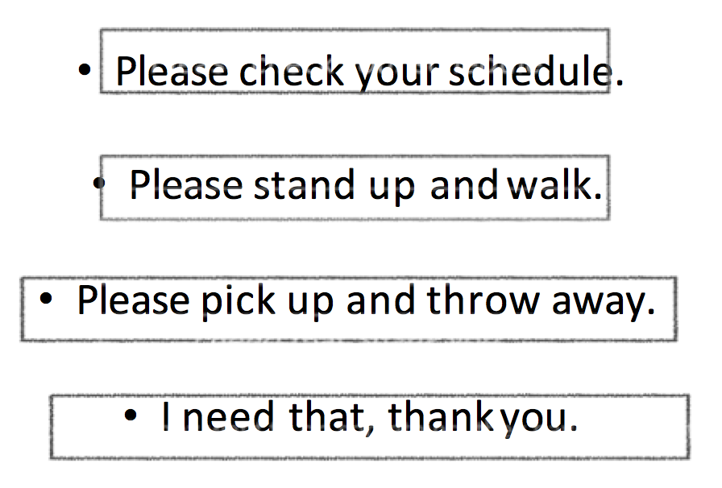
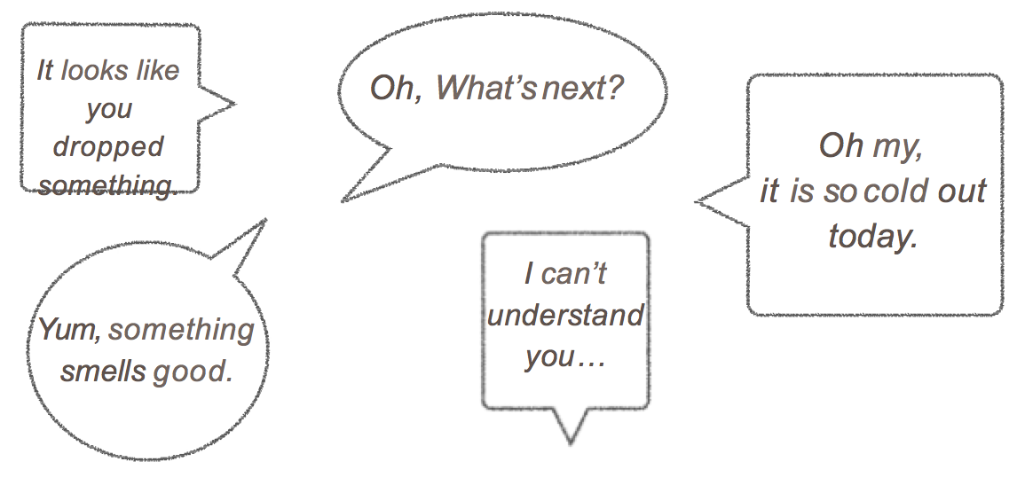
Verbal Prompt (Direct or Indirect)
Explicitly stating the behavior that needs to occur
Example: “it is time to line up for recess.”
A direct prompt might involve the adult saying the entire word or phrase that he is trying to elicit from the student.
A partial or indirect verbal prompt might be providing only the first sound or syllable to cue the student to proceed for the rest.
Notes:
Verbal prompting is the providing of a verbal instruction, cue, or model, or overemphasizing the correct word in an array of choices.
There are two types of verbal prompts: 1-is a direct statement of what to do or say. For example, “come here.” “put it in the trash.” Use of this level of prompt requires that the student understand the direction; not good for students with receptive language weaknesses or students with hearing deficits 2-is an indirect statement that tells the student something about what is expected, but no exactly. For example, “What next?” “Where does it go?”
often most difficult to fade

Slide 15
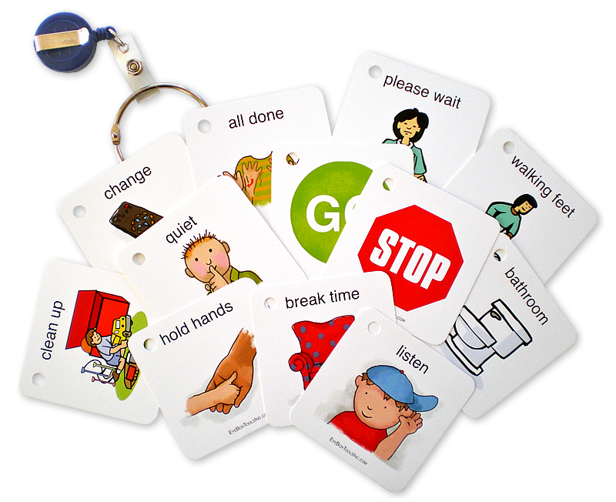
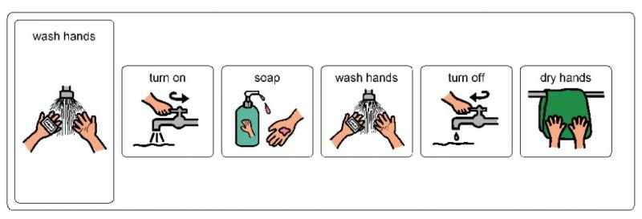
Visual Prompt
Refers to icons/symbols, pictures or visual schedules to complete desired task.
A visual prompt can include a video, photograph or drawing on a medium like paper, a whiteboard, or an electronic device.
Example: Teacher asks learner, “Clap your hands.”
Teacher prompts learner by playing a video of a person clapping his hands.
Notes:
Student refers to icons/symbols, pictures or visual schedules to complete desired task.
ABA research describes Students with Autism Spectrum Disorder as visual thinkers, which means more success on info that is presented visually rather than verbally.
Visual prompts often reduce anxiety and confusion. Unlike the verbal prompts, it does not require intense language skills, just like traffic signs that bilingual people can also understand.

Slide 16
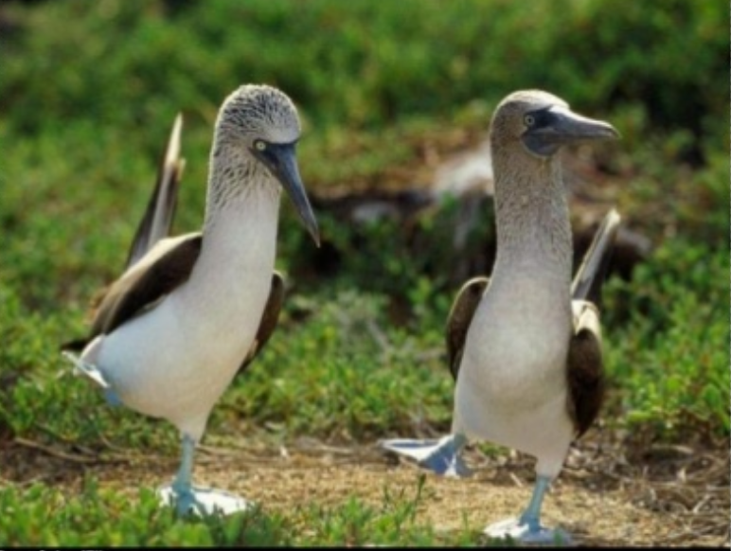
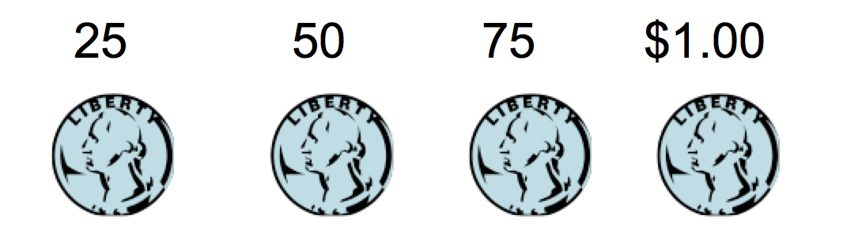
Modeling
Acting out the desired behavior in order to encourage the initiation of that behavior by the student.
Example 1: The teacher sits up tall in her seat with her hands folded on top of the table as students come to a math group. She waits until they copy her behavior.
https://www.youtube.com/watch?v=64t2prEjOM8
https://www.youtube.com/watch?time_continue=19&v=WdYlAWFuPNg
Example 2:
Notes:
Showing the student what you want him/her to do without physically touching. This type of prompt requires that the student have good imitation skills, typically not used so often for students with autism.
Modeling is when you demonstrate a behavior or completion of a task for the learner. For example:
when teaching money skills, you show one quarter at a time, say, “25, 50, 75, $1.00.”

Slide 17
Physical Prompt (Partial)
Light physical touch or direction to encourage student to finish the task.
Partial physical assistance may involve touching the student’s hand to initiate the response and providing minimal physical guidance to get the desired response.
This is a less intrusive physical prompt.
Examples: Teacher asks learner, “Clap your hands.”
Teacher prompts learner by gently touching each of the learner’s two hands and gently nudging the learner’s hands toward each other.
Touching the student’s hand as cue to begin writing. Touch the student’s elbow as a cue to reach for an object.
Notes:
The teacher provides some assistance to guide the learner through a part of the requested activity.

Slide 18
Physical Prompt (Partial)
Examples; a tap to elbow to encourage a choice for lunch
; a tap on the SmartBoard box to indicate the need for a marker selection.
The partial physical assistance prompt can be paired with the direct verbal prompt.
https://www.youtube.com/watch?v=AloUad4kVxQ
http://mast.ecu.edu/modules/ta/lib/media/video01.html
http://mast.ecu.edu/modules/ps/lib/media/video05.html
Any questions so far?
Notes:
The teacher provides some assistance to guide the learner through part of the requested activity.
The video below demonstrates a task analysis for using a vending machine. The instructor is using least to most prompt order to teach this skill. From top to the bottom, she goes by a verbal, model, and physical prompt.
Here is another one where the student is supposed to use a phone to call her mother. From top to the bottom, she goes by a verbal, model, and physical prompt.

Slide 19
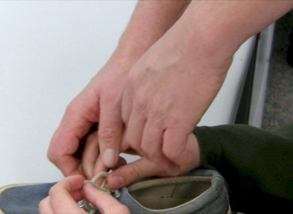
Physical Prompt (Full)
A physical prompt is where the teacher provides
physical contact to guide the learner through
the entire requested activity. (Aka HOH)
Considered the most intrusive prompt.
Usually used to teach a motor response; i.e., when teaching how to purposely use a new toy or object; how to complete a task and put in a finished box, etc…
Example: Teacher asks learner, “Clap your hands.” Teacher prompts learner by holding each of the learner’s hands in his hands and then moving the learners hands through the entire action of hand-clapping. Example: A paraprofessional physically positions Kim’s fingers on the spoon, provides a downward motion into the cereal bowl, then moves Kim’s cereal-filled spoon to her mouth.
https://www.youtube.com/watch?v=fLToV4Pjgac
Notes:
This one refers to providing hand-under-hand guidance to help the student complete the desired task
Example 1: clap your hands appropriately
Eaxample 2: eating cereal at breakfast.

Slide 20
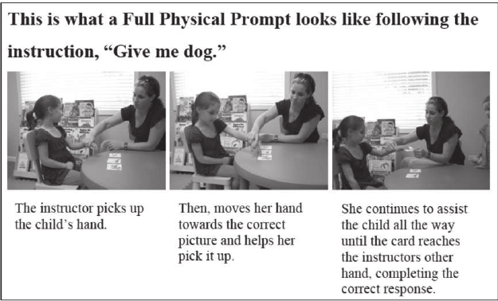
Physical Prompt (Full)
A video-demo for least to most prompting
https://www.youtube.com/watch?v=7UF2kmhiMGw
Notes:
There are three cards on the table, and give me the card with the dog.

Slide 21
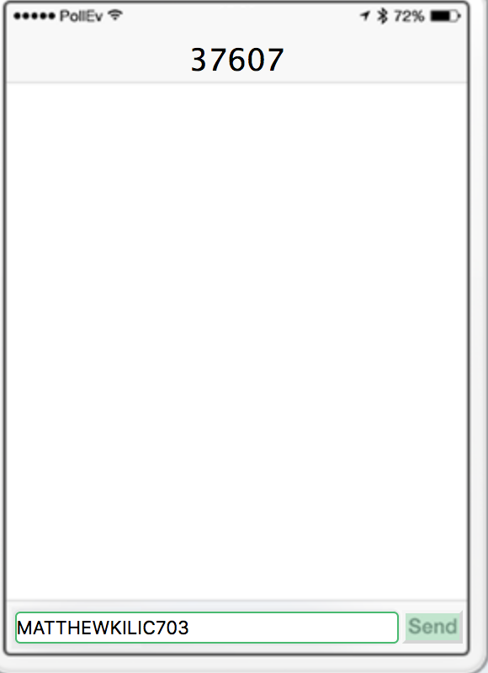
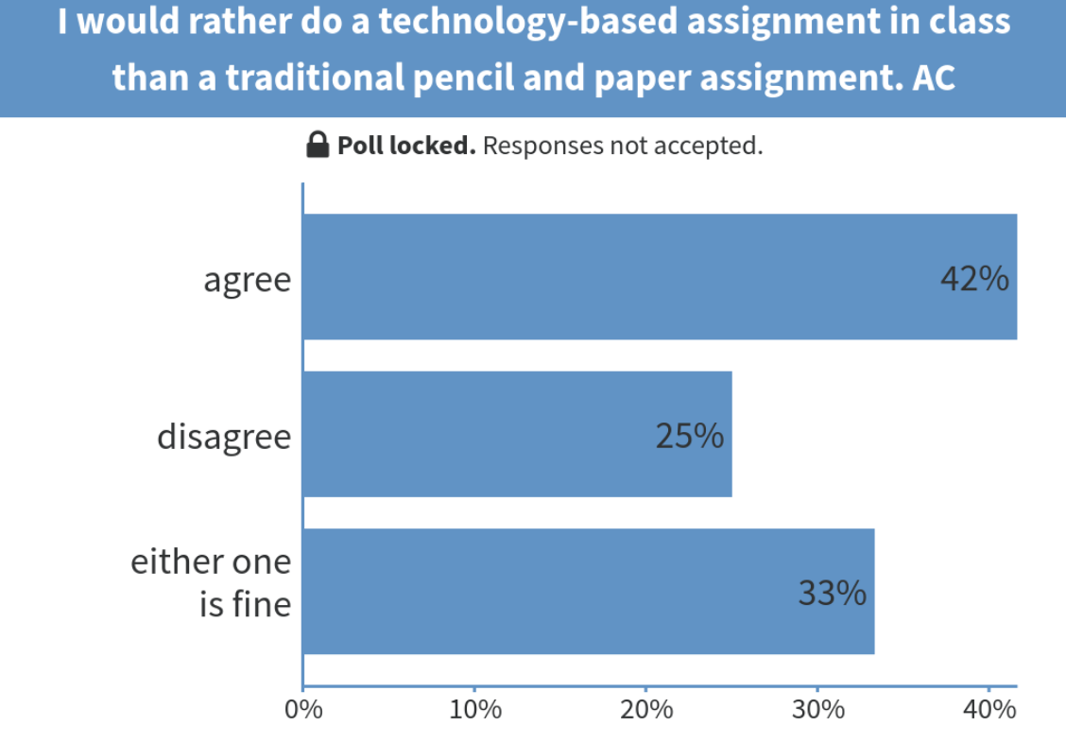
Check point…
Please grab your cell phone, and and text MATTHEWKILIC703 to 37607. Once joined, then send A, B, C, D, E etc. for your answer
Respond to this poll at www. PollEv.com/matthewkilic703
Notes:
Ask the audience a question. Then watch as the chart updates automatically with their responses.
Today is the election day...Yay… do not forget to vote today.

Slide 22
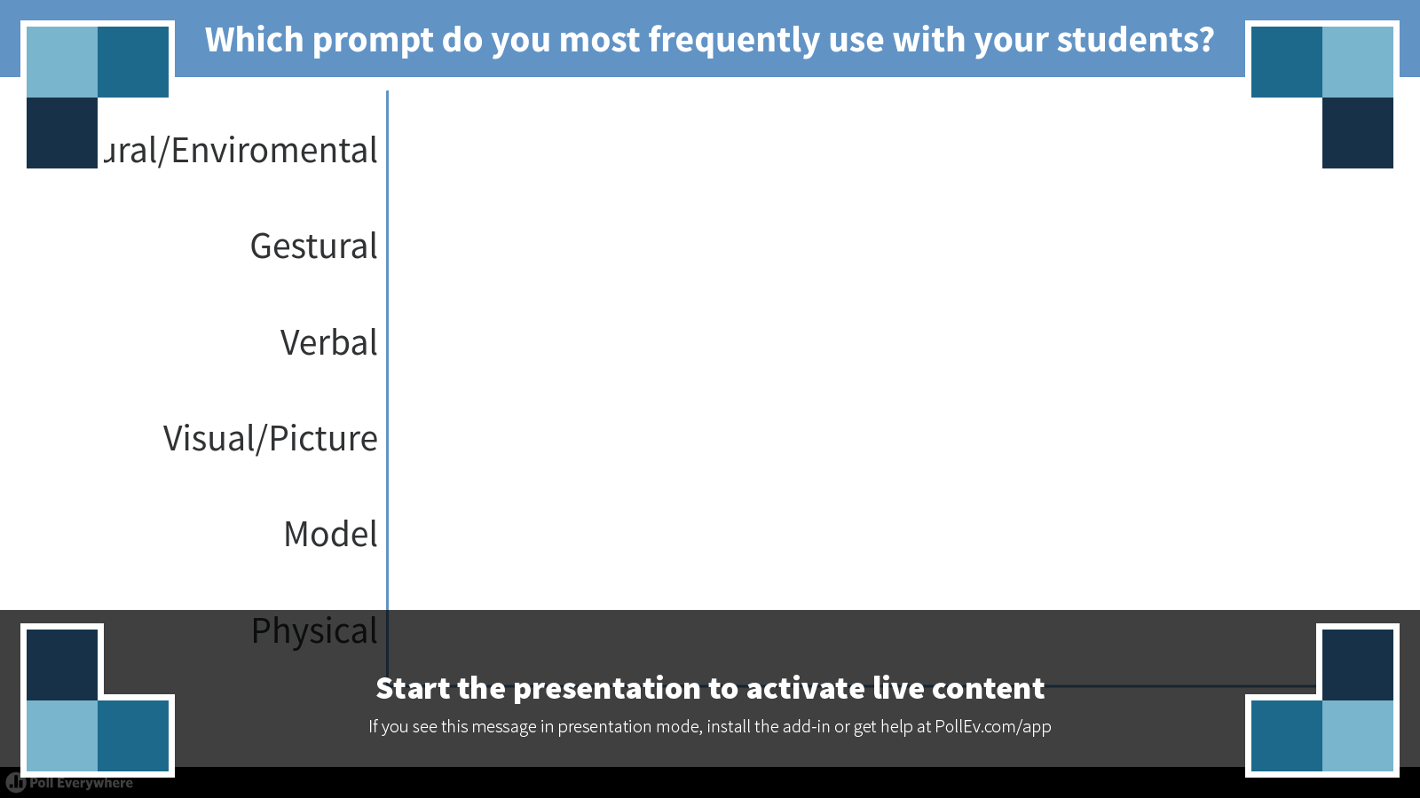
Notes:
This one refers to providing hand-under-hand guidance to help the student complete the desired task

Slide 23
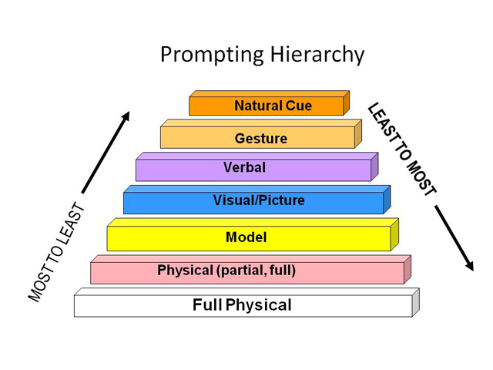

Your Turn - Prompt Hierarchy (10min)
In small groups (of 2 or 3), please discuss the levels of prompts with which you’re familiar.
Discuss what prompts are new to you.
Discuss what prompts you are currently using to address behaviors/academic needs of your students. Be specific with examples.
Figure out a group leader for the whole group discussion.

Slide 24
Your Turn 2- Prompt Hierarchy (10min)
Case Scenario: Suppose you teach a child to “wash hands in the wash basin” initially you instruct the child verbally “wash hands in the washbasin” if the child does not respond, or make an error the teacher repeats the instruction (pauses 5 to 10 seconds) then points to the wash basin. If this does not produce a correct response, the teacher repeats the instruction, (pauses 5 seconds) and, then models washing hands in the basin. If this fails to produce a correct response, the teacher gives the instruction again (pauses) and then manually/physically guides him/her to wash hands in the basin) This is least to most or increasing assistance, prompts hierarchy.
      In your small group, brain-storm a case scenario
      Use various prompts by following the prompt hierarchy to get the task done.
      Figure out a group leader for the discussion with the audience.

Slide 25
What is the ultimate goal?
The most important thing for a paraeducator to remember is that helping a student when he or she could learn to do a task independently is what leads a student to become overly dependent on the paraeducator and not develop skills of dependence….Then what do we need to do???
  Fading: Gradual reduction of cues/prompts and extrinsic reinforcers as the student demonstrates the desired behavior or task.
Fade prompts to allow responses to occur independently!
The reduction of the intensity or magnitude of a particular type of prompt over time while maintaining the reward contingency.
Prompts can be faded in terms of:
Intensity & Location
Notes:
Intentionally plan to FADE prompts/support •
Facilitate independence by VARYING the amount of support, monitoring, and prompting based on need and independent level of student. •
Plan, systematically with the teacher, on when and how to fade.
Replace your support with visuals.
Teach natural, environmental cues.
Aide then fade, considering the least to most prompting .

Slide 26
What is the ultimate goal?
Intensity:
Verbal prompt: Gradual decrease in volume (quietly)
Verbal prompt: Saying less of the word (Bob – “B”)
Visual prompts: Decrease highlighting or coloration to become lighter and lighter until they disappear
Physical prompt: Reduction of tight hand over hand to shadowing
Location:
Full physical hand over hand to wrist, to the elbow, to the shoulder, to next to (within 1 foot, to 3 feet, to 5 feet away, etc.)
Proximity to student: next to student, within line of vision within the classroom, etc.
Notes:
To fade verbal prompts, use full sentence and then partial sentence
To fade visual prompts, use less colors and symbols until they disappear and the student is fine.
To fade physical prompts, use partial physical prompts and turn it into modeling or gesture prompts
You can also fade the prompts by manipulating the location. This is more applicable to psy. prompts.
Start with hoh, then move to the wrist, elbow, shoulder,
Once completely aparted, stay 1 foot, 3 feet, 5 feet, away and just monitor with verbal prompts.

Slide 27
Guidelines for Effective Prompting
Do not provide a prompt for a skill that a student currently performs independently
Gain student attention
Prompt a desired response initially
Use always the least intrusive prompt, especially for learned skills
Prompt from behind when using full physical prompts
Avoid verbal prompts whenever possible
Avoid unplanned prompts (e.g. facial expressions, eye contact)

Slide 28
Guidelines for Effective Prompting
Use prompts in conjunction with reinforcement
All prompts need to be faded over time (Refer to Fade Plan)
After a student masters a skill, discontinue using the prompt
Continue providing reinforcement when the student exhibits the desired response/behavior
Fading prompts are needed to avoid “Prompt Dependency”

Slide 29
Always ask yourself these questions
Can the student participate or carry out this task independently?
Is there another student who can provide support?
If my support is required, how can I first “aide, and then fade” ?
Am I supporting this student out of a need, or out of habit?
Does this student truly need support at this moment or am I just in the habit of offering support in this kind of situation?

Slide 30

Notes:
Remember, especially if you are a one-to-one para, you spent the most time with the student, so you know the student more than everybody in the school.
In olds days, schools were following a one-size fits all approach. Now individualized. Everyone has a unique way of learning.

Slide 31
“We are responsible for those”
who often do not get a second chance.
who often find out what they can not do, before finding out what they are capable of
who will the grab hand of anybody kind enough to offer help
who have difficulties in interpreting social cues that may result in lowered self-esteem or in meeting people or working cooperatively with others
who are unable to distinguish subtle changes in tone of voice
who have difficulty in recognizing the difference between sincere and sarcastic comments.
who have difficulty with oral directions, expressing ideas orally, even when they seem to understand
who have difficulty comprehending while reading aloud
who are unable to concentrate on and to comprehend spoken language when presented rapidly, which causes great difficulty in taking class notes
Notes:
exceptional children

Slide 32
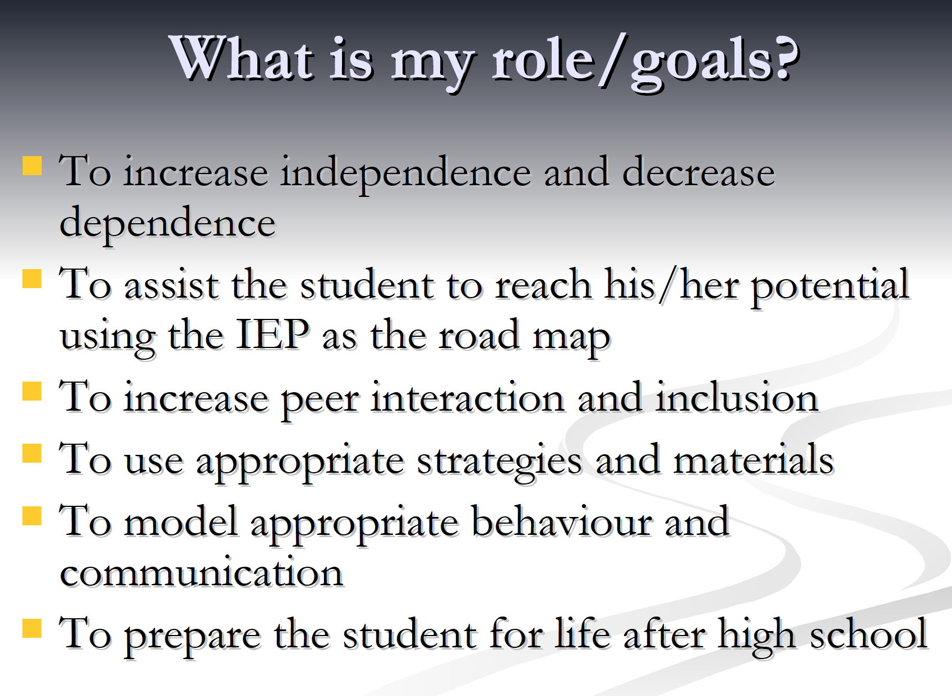

Slide 33

Notes:
looks for ways to increase their independence in school, which makes it a more welcoming place for them.

Slide 34

A recap video about prompting and fading:
https://www.youtube.com/watch?v=9xFEOM4CG-8

Slide 35

The End…☺
        Merci
        Danke
        Gracias
        Diakuiu
        Xièxie
        Shukran
        Tashakkur
        Arigato
        Spasiba
        Thank You!

Slide 36
References:
Alberto, A.A., & Troutman, A.C. (2003). Applied behaviour analysis for teacher. (6th edition). NJ: Merrill Prentice Hall.
Earles, T., Carlson, J., & Bock, S.J. (1998). Instructional strategies to facilitate successful learning outcomes for students with autism. Educating Children and Youth with Autism. Austin, TX: Pro-Ed.
Grandin, T. (2006). Thinking in pictures: My life with autism. Knopf Publishing Group.

